Slide 1
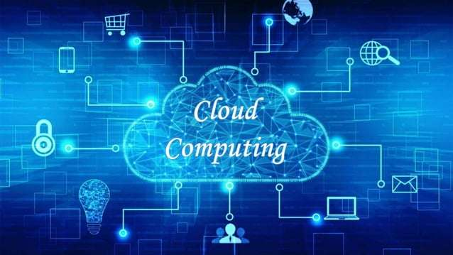
CLOUD COMPUTING

Slide 2
INTRODUCTION
Cloud computing refers to the delivery of computing services over the internet, including storage, processing power, databases, networking, and software, allowing organizations to access and manage resources remotely. Key benefits include scalability, cost efficiency, flexibility, and high availability

Slide 3
CLOUD DEPLOYMENT MODELS
Cloud Deployment Model functions as a virtual computing environment with a deployment architecture that varies depending on the amount of data you want to store and who has access to the infrastructure.
The four main deployment models are :
Public
Private
Hybrid
Community

Slide 4
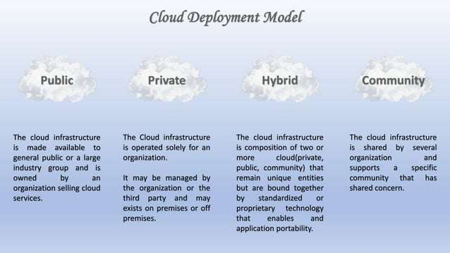

Slide 5
KEY CLOUD PROVIDERS
Amazon Web Services (AWS) Offers a wide range of services including computing, storage, databases,
machine learning, and more. Known for its scalability and extensive global reach.
Microsoft Azure Provides services including computing, networking, databases, AI, and analytics.
Known for its strong integration with Microsoft products and enterprise services.
Google Cloud Focuses on services like data analytics, machine learning, and scalable computing.
Known for its innovative tools and strong data-related services.
IBM Cloud & Oracle Cloud Specialized in enterprise applications, hybrid clouds, and integrating AI and machine learning tools for industry-specific solutions.

Slide 6
SERVICE MODELS:
Infrastructure as a Service (IaaS) Provides virtualized computing resources over the internet.
It includes access to hardware, storage, and networking resources.
Users manage applications and OS, while the provider manages the infrastructure.
Example: AWS EC2, Google Compute Engine, Microsoft Azure Virtual Machines.
Platform as a Service (PaaS) Provides a platform allowing developers to build and deploy applications without worrying
about the underlying infrastructure. It includes operating systems, databases, and development
tools.
Example: AWS Elastic Beanstalk, Google App Engine, Microsoft Azure App Services.
Software as a Service (SaaS) Delivers software applications over the internet.
The provider manages everything from infrastructure to application maintenance, while
users just use the software
Example: Google Workspace, Microsoft Office 365, Salesforce.

Slide 7
